Slide 1
Monitoring And Logging
Technical - Overview
Integration Team
February 2018

Slide 2
AGENDA
Overview
Monitors

Slide 3
“
GPP-SP is a 24 x 7 online system. It is especially required to monitor the application and the payments”

Slide 4

Monitors
GPP-SP health can be monitored in various ways. It is always important to know what to monitor and when
GPP-SP Traces
GPP-SP Database tables
GPP-SP UI

Slide 5
GPP-SP Traces
GPP-SP as an application writes a huge number of traces and logs each and every activity that performs
The size of the trace files varies from 30-50 MB as configured and automatically rolls over once the size limits are reached
GPP Typically writes the below trace files
gppserver_trace.log
gpp_mdp_monitor.log
gpp_gpp_monitors.log
gpp_flow_monitor.log
gpp_error.log
gpp_activity.log

Slide 6
GPP-SP Traces .. Contd
Traces | Details
gppserver_trace.log | This trace will contain all the payment related activities performed by GPP. This will also contain the UI activity logs
gpp_mdp_monitor.log | This trace will monitor the MDP activities. It starts logging when any of the defined (and active) MDPs receive message.
gpp_gpp_monitors.log | This trace is mostly used for defining GPP’s performance as it logs the transaction related activities and also logs the time consumed for a specific transaction
gpp_flow_monitor.log | This trace give the details of execution time taken per flow step of GPP -SP
gpp_error.log | This trace file logs all the errors reported in GPP-SP
gpp_activity.log | This trace file logs all the activities GPP – SP is performing independent of when it is processing a payment or not.

Slide 7
GPP-SP Database table
GPP-SP as an application writes information about payments in several DB tables. These tables can be queried and fetch information about a particular payment.
DB Tables
Minf
Message_External_Interaction
Errorlog
Message_Backout

Slide 8
GPP-SP Database table .. CONTD
Sample queries
Table | Query
Minf | select * from minf where p_mid = <<Enter MID>>;
Message_External_Interaction | select * from message_external_interaction where mid = <<Enter MID>>;

Slide 9
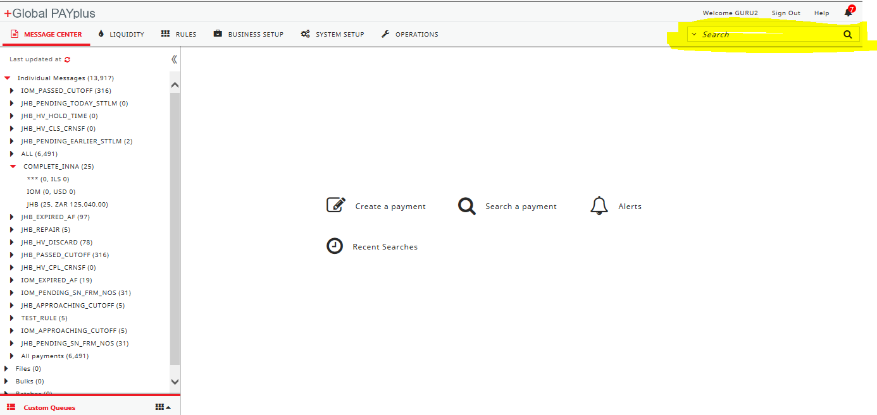
GPP-SP UI
GPP-SP UI can be used by the authorized user to enquire informations about any specific payments. GPP uses elastic search technology to return the searched payments at rapid speed.
Payment can be searched directly on to the main login page.

Slide 10
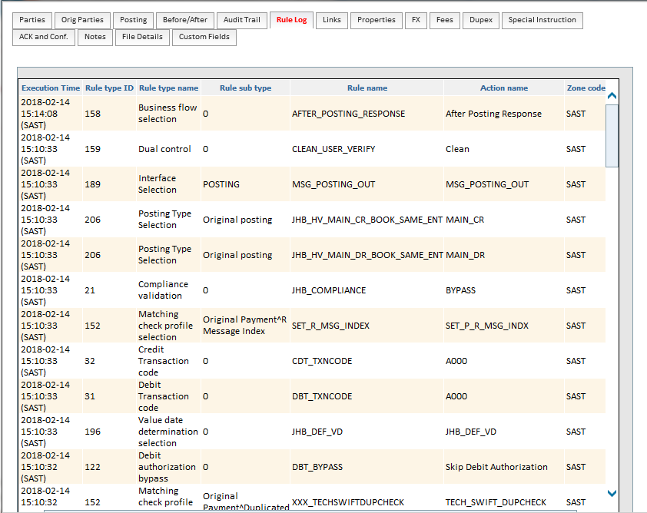
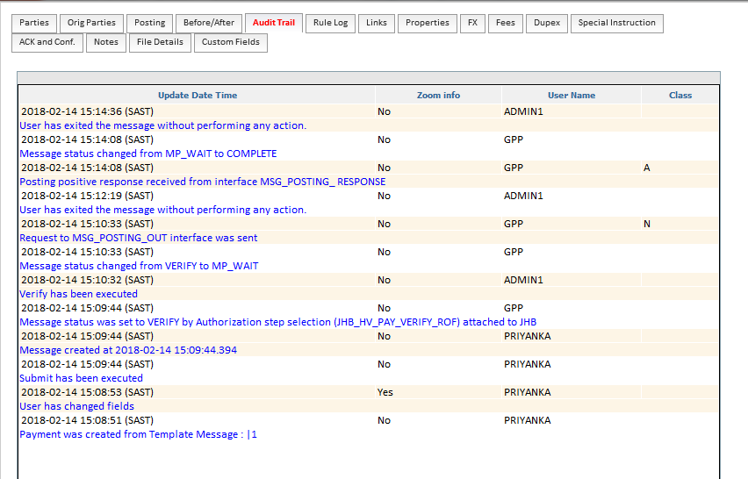
GPP-SP UI .. COND
User can view what all rules have been executed for a payment.
User can also look into the audit trails for a particular payment.

Slide 11
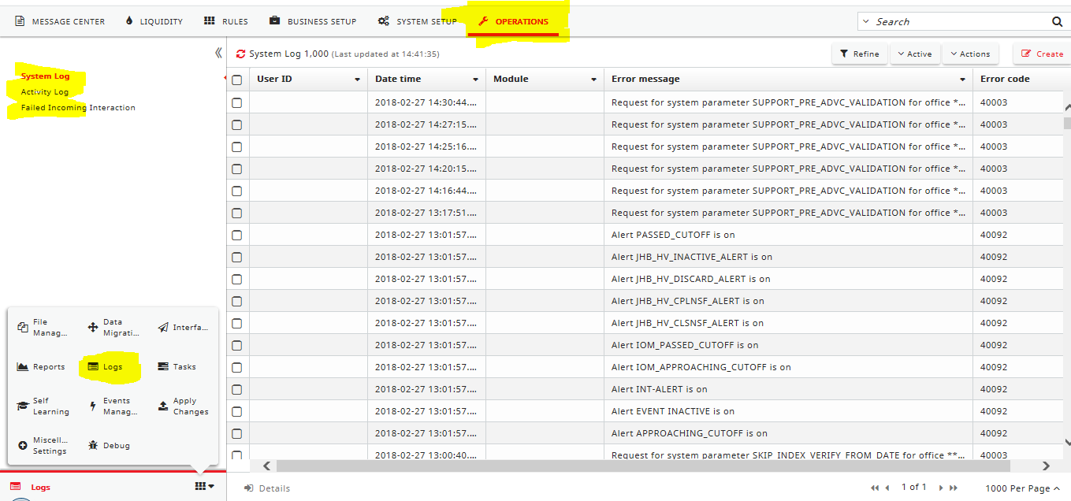
GPP-SP UI .. CONTD
Operations->Logs will present two options to view logs.
System Log
Activity Log

Slide 12
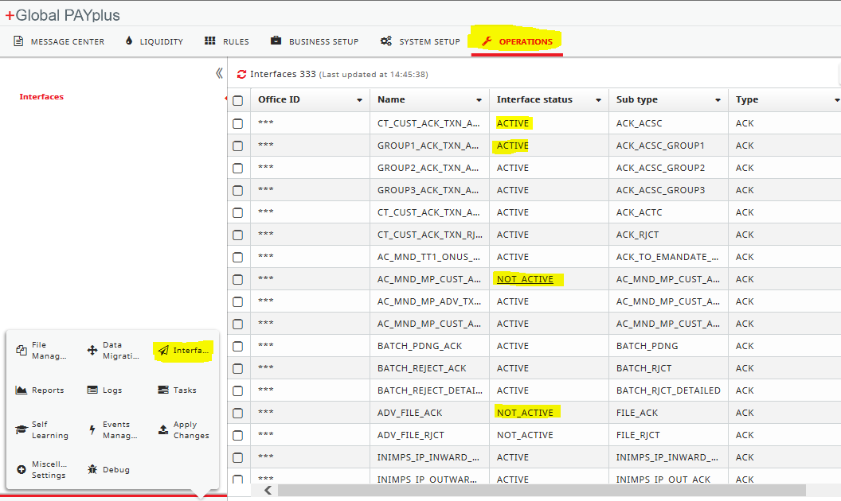
GPP-SP UI .. CONTD
Interfaces (Operations->Interfaces) will list all the interfaces defined in GPP-SP. The status of these interfaces can be monitored and controlled from the UI

Slide 13
Thank you
Arnab Podder
Integration Team
Arnab.podder@finastra.com

